Slide 1
COMP 2068 Advanced Web Programming
Lesson 2 – Part 2 JavaScript
Essentials

Slide 2
Intro to JavaScript

Slide 3
How to code JavaScript statements
A JavaScript statement has a syntax that's similar to the syntax of Java.
Whitespace refers to the spaces, tab characters, and return characters in the code, and it is ignored by the compiler.
As a result, you can use spaces, tab characters, and return characters to format your code so it's easier to read.
In some cases, JavaScript will try to correct what it thinks is a missing semicolon by adding a semicolon at the end of a split line.

Slide 4
How to code JavaScript statements (continued)
The basic syntax rules
JavaScript is case-sensitive.
JavaScript ignores extra whitespace within statements.
Each JavaScript statement ends with a semicolon.
How to split a statement over two or more lines
Split a statement after:
an arithmetic or relational operator such as +,-,*,/,=,==,>, or <
an opening brace ( { ), bracket ( [ ), or parenthesis
a closing brace ( } )
Do not split a statement after:
an identifier, a value, or the return keyword
a closing bracket ( ] ) or parenthesis

Slide 5
How to create identifiers
Identifiers are the names given to variables, functions, objects, properties, and methods.
In camel casing, all of the words within an identifier except the first word start with capital letters.
Rules for creating identifiers
Identifiers can only contain letters, numbers, the underscore, and the dollar sign.
Identifiers can't start with a number.
Identifiers are case-sensitive.
Identifiers can be any length.
Identifiers can't be the same as reserved words.
Avoid using global properties and methods as identifiers. If you use one of them, you won't be able to use the global property or method with the same name.

Slide 6
How to create identifiers (continued)
Valid identifiers in JavaScript:
subtotal
taxRate
index_1
calculate_click
$log
Camel casing versus underscore notation:
taxRate tax_rate
calculateClick calculate_click
emailAddress email_address

Slide 7
Naming recommendations
Use meaningful names for identifiers. That way, your identifiers aren't likely to be reserved words or global properties.
Be consistent: Either use camel casing (taxRate) or underscores (tax_rate) to identify the words within the variables in your scripts.
If you're using underscore notation, use lowercase for all letters.
Please Note: camel casing is the conventional standard for Node.js developers

Slide 8
Reserved Words

Slide 9
How to use objects, methods, and properties
An object has methods that perform functions that are related to the object as well as properties that represent the data or attributes that are associated with the object.
When you call a method, you may need to pass one or more parameters to it by coding them within the parentheses after the method name, separated by commas.
The window object is the global object for client-side JavaScript, and JavaScript lets you omit the object name and dot operator (period) when referring to the window object.
The Syntax for calling a method of an object
objectName.methodName (parameters)

Slide 10
Common methods of the window object

Slide 11
The primitive data types
The number data type
The number data type is used to represent an integer or a decimal value that can start with a positive or negative sign.
An integer is a whole number.
A decimal value can have one or more decimal positions to the right of the decimal point.
If a result is stored in a number data type that is larger or smaller than the data type can store, it will be stored as the value Infinity or -Infinity.
The Boolean data type
The Boolean data type is used to represent a Boolean value. A Boolean value can be used to represent data that has two possible states: true or false.

Slide 12
The primitive data types (continued)
Floating point numbers
In JavaScript, decimal values are stored as floating-point numbers. In that format, a number consists of a positive or negative sign, one or more significant digits, an optional decimal point, optional decimal digits, and an optional exponent.
Unless you're developing an application that requires the use of very large or very small numbers, you won't have to use floating-point notation to express numbers.
The string data type
The string data type represents character (string) data. A string is surrounded by double quotes or single quotes. The string must start and end with the same type of quotation mark.
An empty string is a string that contains no characters. It is entered by typing two quotation marks with nothing between them.

Slide 13
How to code numeric expressions
To code a numeric expression, you can use the arithmetic operators to operate on two or more values.
The modulus operator returns the remainder of a division operation.
An arithmetic expression is evaluated based on the order of precedence of the operators.
To override the order of precedence, you can use parentheses.
Because the use of increment and decrement operators can be confusing, the recommendation is that you only use these operators in expressions that consist of just a variable name followed by the operator.

Slide 14
How to code numeric expressions (continued)
Common arithmetic operators
The order of precedence for arithmetic expressions

Slide 15
How to work with numeric variables
A variable stores a value that can change as the program executes.
To declare a variable, code the keyword var and a variable name.
To declare more than one variable in a single statement, code var and the variable names separated by commas.
Within an expression, a numeric literal is a valid integer or decimal number that isn't enclosed in quotation marks.
To assign a value to a variable, you use an assignment statement that consists of the variable name, an assignment operator, and an expression.
When appropriate, you can declare a variable and assign a value to it in a single statement.
If you use a plus sign in an expression and both values are numbers, JavaScript adds them
If both values are strings, JavaScript concatenates them.
If one value is a number and one is a string, JavaScript converts the number to a string and concatenates.
When you do some types of arithmetic operations with decimal values, the results aren't always precise (although they are extremely close) – this is because decimal values are stored internally as floating-point numbers.

Slide 16
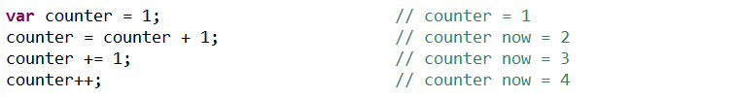
Numeric Variables – Examples

Slide 17
How to work with string and Boolean variables
To assign values to string variables, you can use the + and += operators, just as you use them with numeric variables.
To concatenate two or more strings, you can use the + operator.
Within an expression, a string literal is enclosed in quotation marks.
Escape sequences can be used to insert special characters within a string like a return character that starts a new line or a quotation mark.
If you use a plus sign in an expression and both values are strings, JavaScript concatenates them.

Slide 18
Common Escape Sequences

Slide 19
How to use the parselnt and parseFloat methods
The window object provides parselnt and parseFloat methods that let you convert string values to integer or decimal numbers.
When you use the prompt method or a text box to get numeric data that you're going to use in calculations, you need to use either the parselnt or parseFloat method to convert the string data to numeric data.
NaN is a value that means "Not a Number". It is returned by the parselnt and parseFloat methods when the value that's being parsed isn't a number.
When working with methods, you can embed one method in the parameter of another. This is sometimes referred to as object chaining.

Slide 20
How to code conditional expressions
A conditional expression uses the relational operators to compare the results of two expressions.
A compound conditional expression joins two or more conditional expressions using the logical operators.
The isNaN method tests whether a string can be converted to a number. It returns true if the string is not a number and false if the string is a number.

Slide 21
The === operator
Widely used in Node apps, JavaScript also contains the === operator
How is this different from the == operator?
== checks if 2 values are equal
=== checks if 2 values are equal as well as if the values have the same data type (aka “equality WITHOUT type coercion”)

Slide 22
A == / === Quiz
For each item below, write down whether the expression will evaluate to true or false
0 == false
0 === false
1 == "1"
1 === "1"
null == undefined
null === undefined
'0' == false
'0' === false

Slide 23
A == / === Quiz Answers
0 == false // true
0 === false // false
1 == "1" // true
1 === "1" // false
null == undefined // true
null === undefined // false
'0' == false // true
'0' === false // false

Slide 24
How the logical operators work
Both tests with the AND operator must be true for the overall test to be true.
At least one test with the OR operator must be true for the overall test to be true.
The NOT operator switches the result of the expression to the other Boolean value.
For example, if an expression is true, the NOT operator converts it to false.
To override the order of precedence when two or more logical operators are used in a conditional expression, you can use parentheses.

Slide 25
How to code if statements
An if statement always has one if clause. It can also have one or more else if clauses and one else clause at the end.
The statements in a clause are executed when its condition is true. Otherwise, control passes to the next clause. If none of the conditions in the preceding clauses are true, the statements in the else clause are executed.
If necessary, you can code one if statement within the if, else if, or else clause of another if statement. This is referred to as nesting if statements.
The Syntax of the if statement
If (condition-1)
{ statements }
else if (condition-2)
{ statements }
else if (condition-n)
{ statements }
else
{ statements }

Slide 26
How to code while and do-while loops
The while statement creates a while loop that contains a block of code that is executed while its condition is true. This condition is tested at the beginning of the loop, and the loop is skipped if the condition is false.
The do-while statement creates a do-while loop that contains a block of code that is executed while its condition is true. However, its condition is tested at the end of the loop instead of the beginning, so the code in the loop will always be executed at least once.
The Syntax of a while loop
while ( condition)
{ statements }
The Syntax of a do-while loop
do
{ statements }
while (condition);

Slide 27
How to code for loops
The for statement is used when you need to increment or decrement a counter that determines how many times the for loop is executed.
Within the parentheses of a for statement, you code an expression that initializes a counter (or index) variable, a conditional expression that determines when the loop ends, and an increment expression that indicates how the counter should be incremented or decremented each time through the loop.
The syntax of a for statement
for (counterInitialization; condition; incrementExpression)
{ statements }

Slide 28
How to work with objects, functions, and events

Slide 29
Dot Notation
Like other C-based languages, JavaScript uses Dot Notation when referencing properties, methods, or events of objects. For example:
student.name = ‘Sue’; // set the name property of the student object
student.register(); // call the register() method of the student object

Slide 30
How to use Date and String objects
To create a Date object and assign it to a variable, use the syntax shown above. Then, you can use the Date methods with the variable.
When you declare a string variable, a String object is automatically created. Then, you can use the String methods with the variable.
A few methods of a Date object
A few methods of a String object

Slide 31
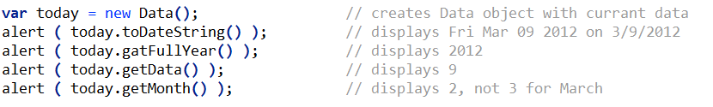
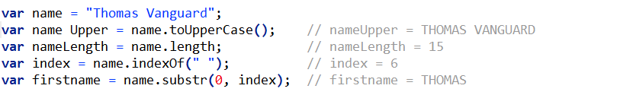
Examples of the Date and String objects

Slide 32
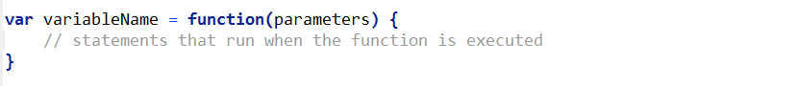
How to create and call an anonymous function
A function is a block of code that can be called by other statements in the program. When the function ends, the program continues with the statement after the calling statement.
A function can require that one or more parameters be passed to it when the function is called. In the calling statement, these parameters can also be referred to as arguments.
To return a value to the statement that called it, a function uses a return statement. When the return statement is executed, the function returns the specified value and ends.
An anonymous function is one that is coded as shown below. Technically, the function has no name, it is stored in a variable, and it is referred to by the variable name.
In the JavaScript for an application, an anonymous function must be coded before any statements that call it. Otherwise, an error will occur.

Slide 33
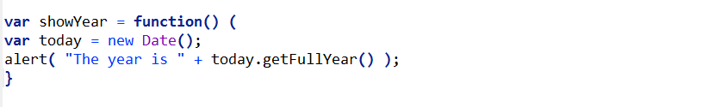
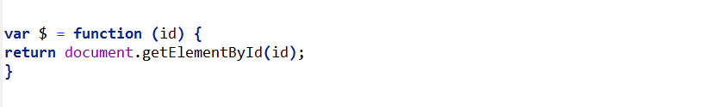
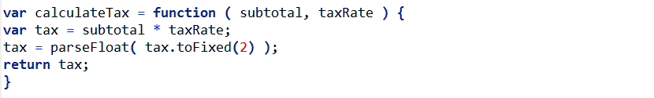
Function Examples
An anonymous function with no parameters that doesn't return a value
An anonymous function with one parameter that returns a DOM element
An anonymous function with two parameters that returns a value

Slide 34
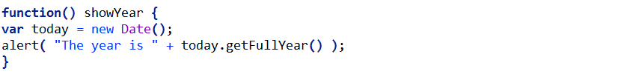
How to create and call a named function
A named function is one that is coded as shown above. This is just another way to code functions.
In contrast to an anonymous function, a named function doesn't have to be coded before any statements that call it.
The syntax for a named function
A named function with no parameters that doesn't return a value

Slide 35
When and how to use local and global variables
The scope of a variable or function determines what code has access to it.
Variables that are created inside a function are local variables, and local variables can only be referred to by the code within the function.
Variables created outside of functions are global variables, and the code in all functions have access to all global variables.
If you forget to code the var keyword in a variable declaration, the JavaScript engine assumes that the variable is global. This can cause debugging problems.
In general, it's better to pass local variables from one function to another as parameters than it is to use global variables. That will make your code easier to understand with less chance for errors.

Slide 36
How to work with arrays

Slide 37
How to create an array and refer to its elements
An array can store one or more elements. The length of an array is the number of elements in the array.
One way to create an array is to use the new keyword, the name of the object (Array), and a set of parentheses that contains a length parameter. If you don't specify a length, the array doesn't contain any elements. If you specify a length, each element is set to undefined.
The other way to create an array is to code a set of brackets with or without a list of elements.
To refer to the elements in an array, you use an index where 0 is the first element, 1 is the second element, and so on.
The syntax for creating an array
Using the new keyword with the Array object name
var arrayName = new Array(length);
Using the brackets literal
var arrayName = [];

Slide 38
How to add and delete array elements
One way to add an element to the end of an array is to use the length property as the index.
If you add an element at a specific index that isn't the next one in sequence, undefined elements are added to the array between the new element and the end of the original array.

Slide 39
Array Examples

Slide 40
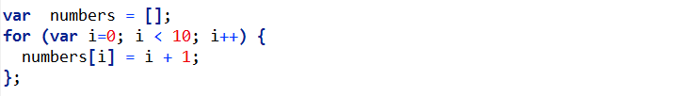
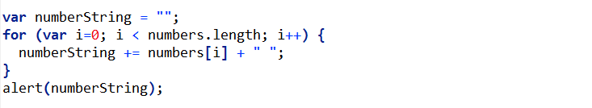
How to use for loops to work with arrays
When you use a for loop to work with an array, you can use the counter for the loop as the index for the array.
Code that puts the numbers 1 through 10 Into an array
Code that displays the numbers array created above

Slide 41
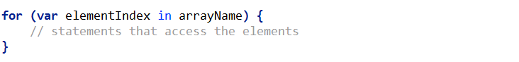
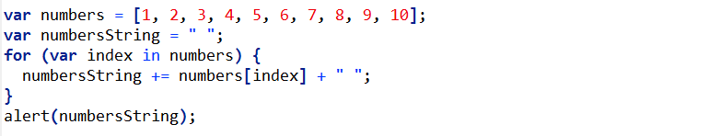
How to use for-in loops to work with arrays
You can use a for-in statement to create a for-in loop that accesses only those elements in an array that are defined.
The syntax of a for-In loop
A for-In loop that displays the numbers array In a message box

Slide 42
How to use the methods of an Array object
The push and pop methods are commonly used to add elements to and remove elements from the end of an array.

Slide 43
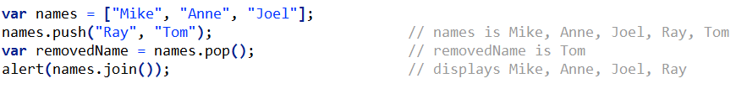
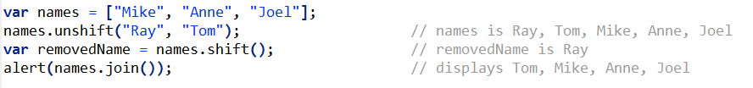
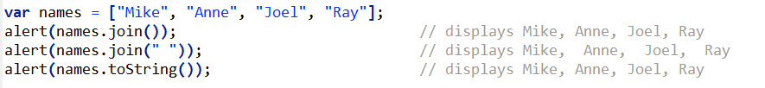
Array method examples
How to use the push and pop methods to add and remove elements
How to use the unshift and shift methods to add and remove elements
How to use the join and toString methods

